Slide 1

AICP: Image module
Day 4 : Deep Learning Theory
Guillaume Witz
Data Science Lab, University of Bern

Slide 2
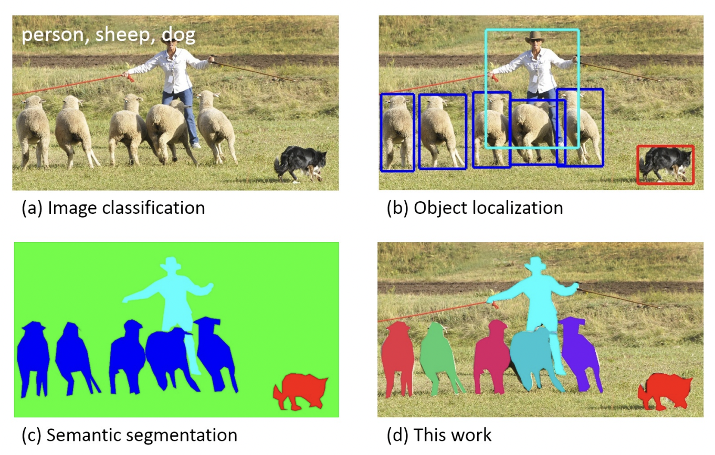
Classical Computer Vision tasks with NN
Classification
Object detection
Semantic segmentation
Instance segmentation
Lin T.-Y. et al. arXiv:1405.0312, 2014

Slide 3
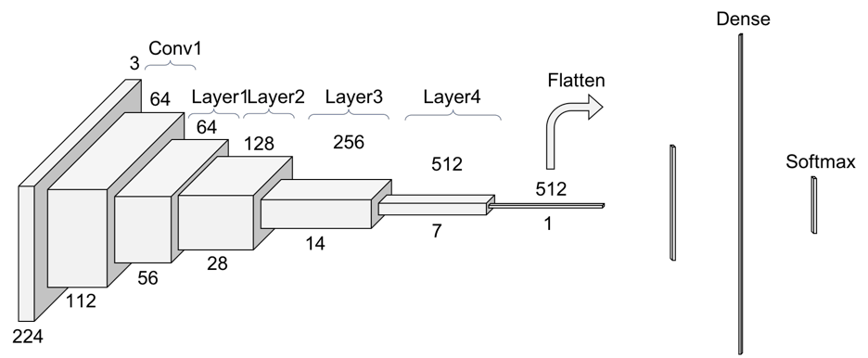
You will often see this kind of NN schema
In the following slides we will try to make it clear what this represents !

Slide 4
Let’s start with simple linear regression

Slide 5
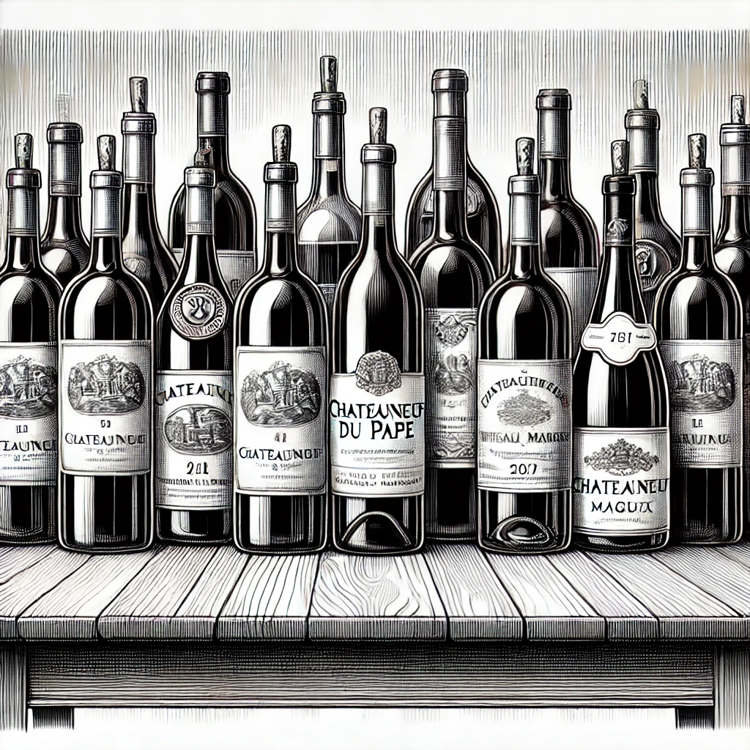
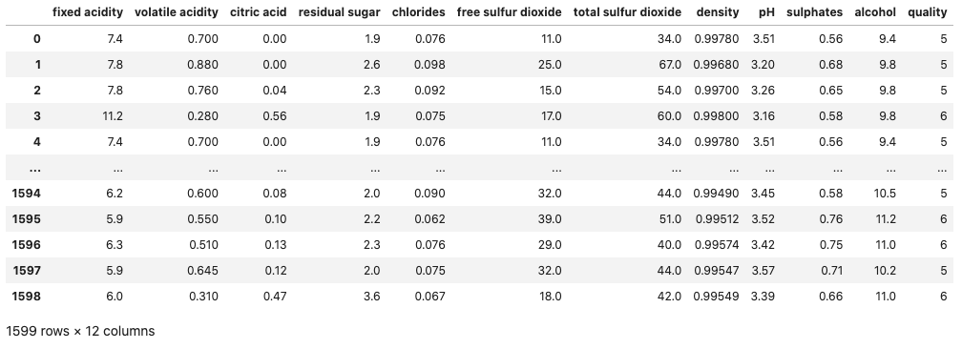
Wine dataset
Measure chemical properties
Wine acidity
Wine alcohol
Wine sugar
…

Slide 6
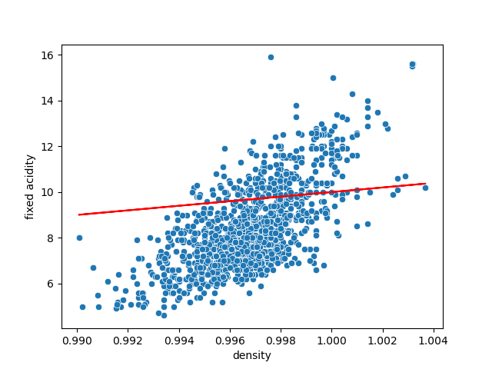
The simplest ”AI”: linear regression
Can we predict acidity using density?
Model: a simple line
y = a*x + b
“Fixed acidity” = w₁ * “density” + w₀
Target
Feature
Parameters / weights

Slide 7
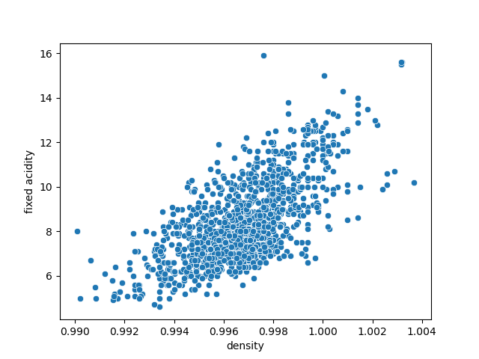
The simplest ”AI”: linear regression
Can we predict acidity using density?
Model: a simple line
y = a*x + b
“Fixed acidity” = w₁ * “density” + w₀
Goal: find the best w₁, w₀ to describe the training data

Slide 8
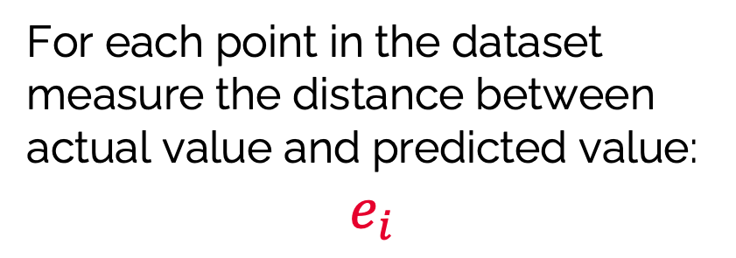
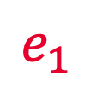
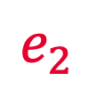
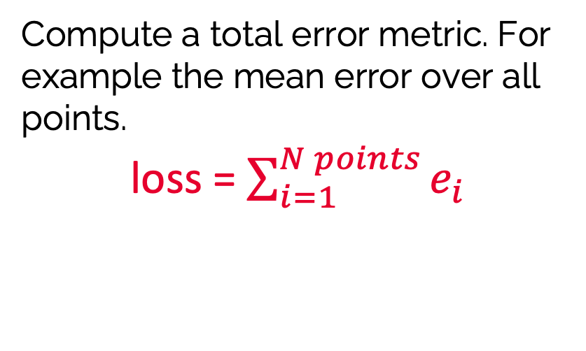
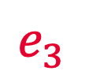
The simplest ”AI”: linear regression
How do we estimate how good a model is ?

Slide 9
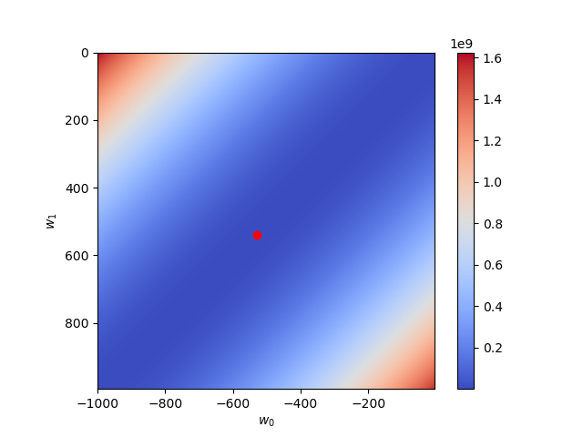
The simplest ”AI”: linear regression
We can try all possible values for our parameters
For each pair of values we get a loss
From all the losses, the best model is the one with the smallest value
If we are close to the optimum, changing a bit a weight is not dramatic -> the loss is “smooth”
“Fixed acidity” = w₁ * “density” + w₀
Bad region
Good region

Slide 10
Number of features and parameters
Generally, models have many more features and parameters to handle
“Fixed acidity” = w₁ * “density” + w₀
Bad region
y = w₁ * f₁ + w₂ * f₂ + … w_{n} * f_{n} + w₀
Good region
To find the best value, we would have to explore a gigantic number of combinations of w₁, w₂, … w_{n}
In deep learning we would have billions of parameters: we need another solution!

Slide 11
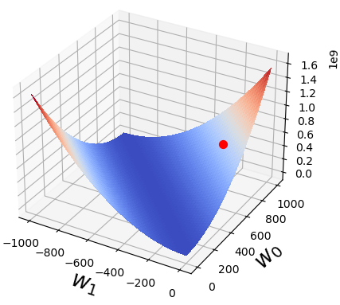
Weights space as mountains and hills
“Fixed acidity” = w₁ * “density” + w₀
Bad region
Good region
If we start at a random position (random weights), how can we find the deepest valley == the smallest loss == best model ?

Slide 12
Weights space as mountains and hills
Bad region
Good region
We can view the loss function space as a plane with mountains and hills.
If we start at a random position (random weights), how can we find the deepest valley == the smallest loss == best model ?

Slide 13
Follow the slope!
Check in which direction the slope is steepest
Take one step in that direction
Continue until you are in a “flat” region and new steps don’t change the location much
The same approach is used in hyperspaces with billions of parameters.
This powerful method is called Gradient Descent !

Slide 14

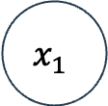

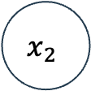


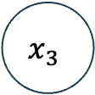
From equation to NN
A neural network is just a representation of the type of equations used for linear regression. For example here we use three features to predict the grade.
acidity
y
alcohol
sugar
f(acidity, alcohol, sugar) = w₁ *acidity - w₂*alcohol + w₃*sugar + w₀ = y = Prob(grade)

Slide 15
NN layer
f(acidity, alcohol, sugar) = w₁ *acidity - w₂*alcohol + w₃*sugar + w₀ = y = Prob(grade)
acidity
y
alcohol
sugar
Layer

Slide 16
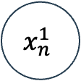

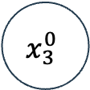


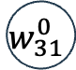

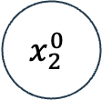
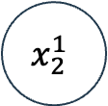

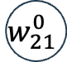

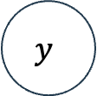
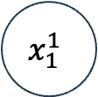
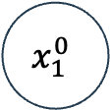

Multiple layers
Layer 0
Instead of directly outputting a value, we output a series of them.
We don’t use these outputs directly, they are “hidden”
We’ll use them as new inputs for the next layer!
…

Slide 17
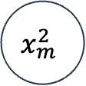
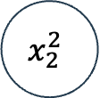
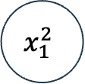
Multiple layers
Inputs for new layer
Outputs for new layer
Layer 0
Layer 1
…
…

Slide 18
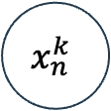
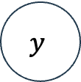
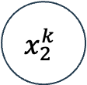
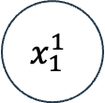
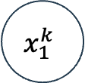
Multiple layers
Final output after k layers
Layer 0
Layer 1
…
…
…

Slide 19
What are our features in the case of images?
Pixels!

Slide 20
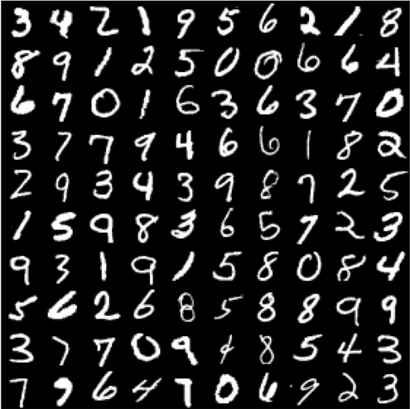
MNIST example: classify 10 numbers

Slide 21
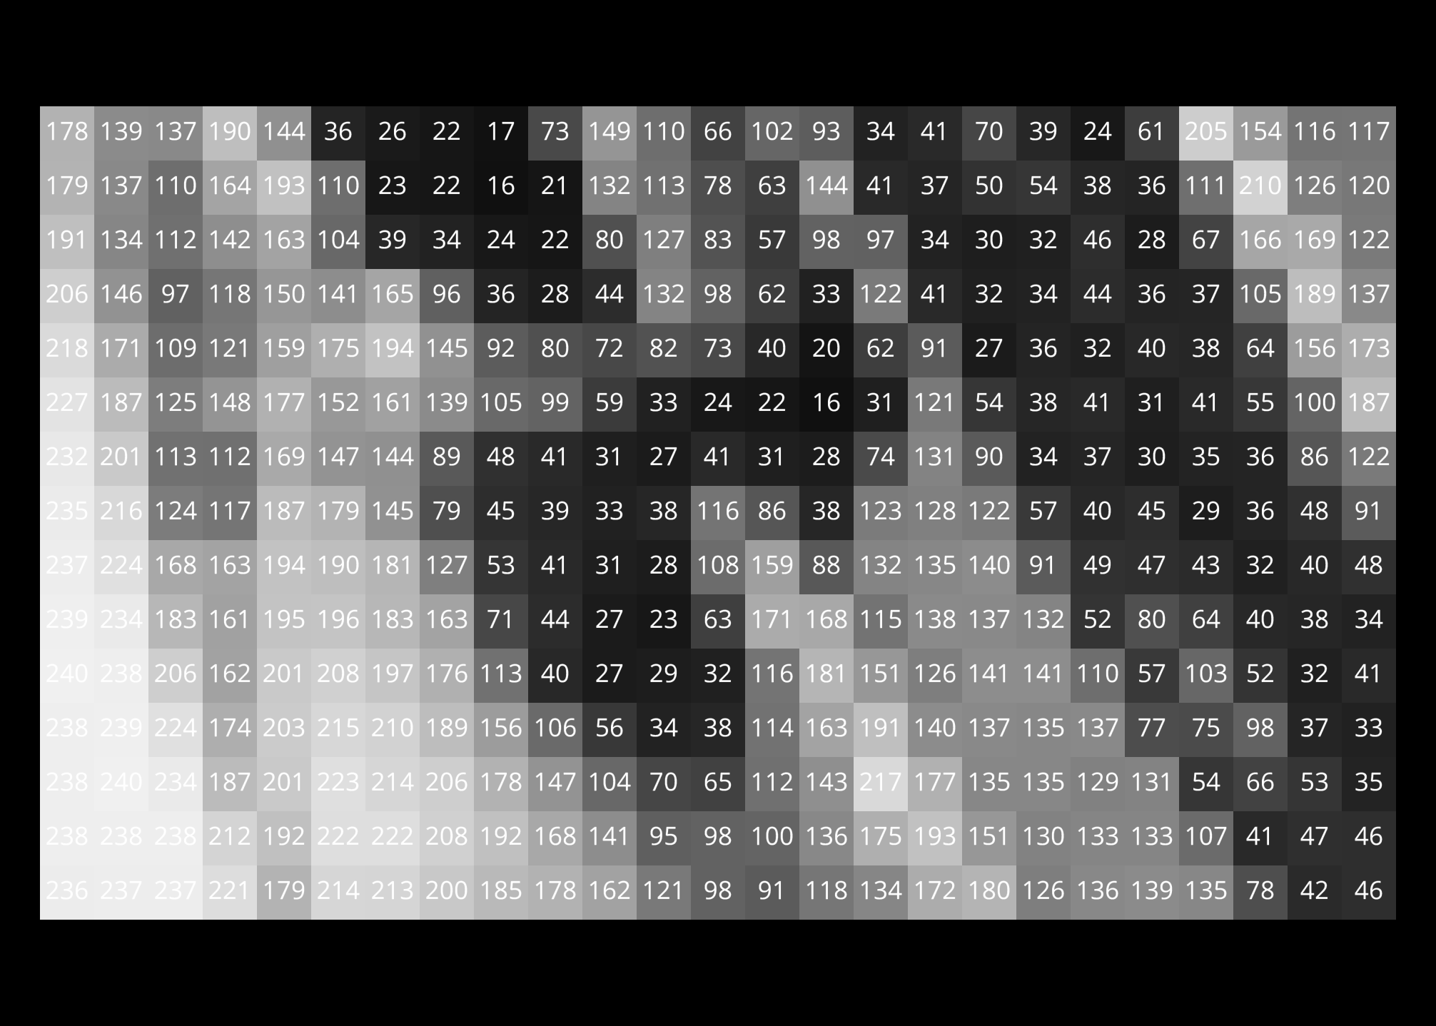
Linearizing an image
165
96
36
28
44
The x_{i} inputs are just a list of numbers (unlike an image which is a 2D list of numbers).
In order to pass an image as input, we can ”flatten” or “unwrap” the image.

Slide 22
Linearizing an image
165
96
36
28
44
194
145
92
80
72
161
139
We append all pixel rows to a long 1D list

Slide 23
Linearizing an image
165
96
36
28
44
194
145
92
80
72
161
139
We have now one long list of numbers which are our input features!
…
45
39
33

Slide 24
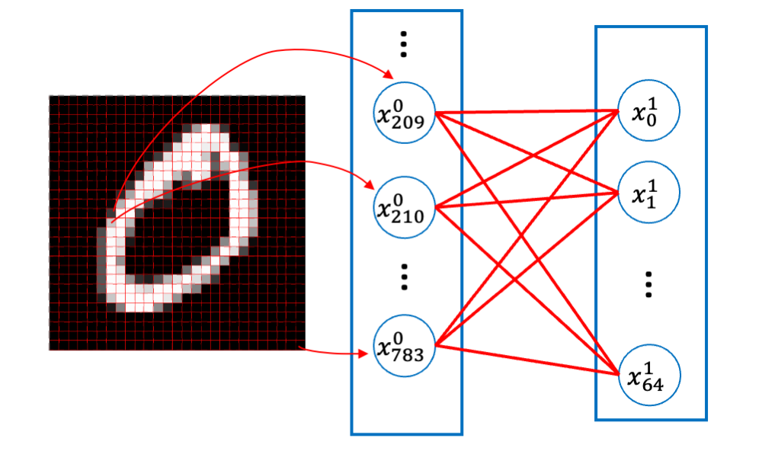
On a real MNIST image

Slide 25
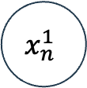
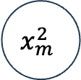
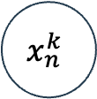



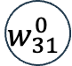

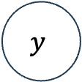

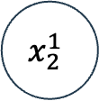
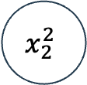
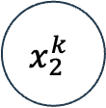
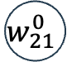

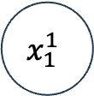

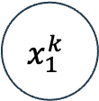

Pixels as input
Layer 0
Layer 1
…
…
…

Slide 26
Pixels as input
…
Layer 0
Layer 1
156
22
150
…
…
…
…
The list of pixels is now our input to the network.

Slide 27
Pixels as input
…
Layer 0
Layer 1
156
22
150
…
…
…
…
We will use only two layers in our model.
The output can take 10 different values, one per number, Our output needs 9 units.

Slide 28
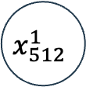
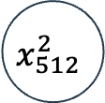
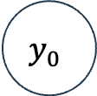



Categories as output
…
Layer 0
Layer 1
156
22
150
…
…
…
…
ReLU
ReLU
Don’t forget that we need non-linearities in our system

Slide 29
Taking into account local pixel structure: convolutional networks

Slide 30
Previous simplistic approach
165
96
36
28
44
194
145
92
80
72
161
139
…
45
39
33

Slide 31












Images have local structure
…
Layer 0
156
22
150
When linearizing an image, we connect all pixels with all pixels. But images have a local structure. We need to capture this local information.

Slide 32


Convolutions
In a convolution, a small image (a filter) travels across an image and performs a local multiplication and sum operation.
1
1
Filter
(1*2+1*5+1*4+1*5)/4 = 13/4 = 3.25
1
1
Region on which filter currently operates
Image
Filtered Image

Slide 33




Convolutions
In a convolution, a small image (a filter) travels across an image and performs a local multiplication and sum operation.
Region on which filter currently operates
Image
Filtered Image

Slide 34
Convolutions
In a convolution, a small image (a filter) travels across an image and performs a local multiplication and sum operation.
Image
Filtered Image

Slide 35
Convolutions
The filter doing the convolution does not have to be 2x2 and does generally not contain 1’s. The filter can have:
any size
1
1
1
1
1
1
1
1
1
1
1
Filter
1
1
any structure
12
1
7
6
9
1
3
5
8

Slide 36


Convolutions / Filters
Depending on the filter, the filtered image or response will highlight different structures.
In classical computer vision the filters are designed by a specialist
In deep learning the filters are learned. The weights are the filters!
Original image
w₀₀
w₀₁
w₀₂
w₁₀
w₁₁
w₁₂
w₂₀
w₂₁
w₂₂
Various filters applied to the image

Slide 37

Typical Convolutional network
The network takes an image as input
Input image

Slide 38

Typical Convolutional network
The network takes an image as input
It gets filtered multiple times, to reveal different structures
Input image
Series of images filtered with a series of trained filters

Slide 39

Typical Convolutional network
The network takes an image as input
It gets filtered multiple times, to reveal different structures
Images are aggregated into a layer
Input image
All images in a filtering round are aggregated

Slide 40

Typical Convolutional network
The network takes an image as input
It gets filtered multiple times, to reveal different structures
Images are aggregated into a layer
Input image
All images in a filtering round are aggregated

Slide 41

Typical Convolutional network
The network takes an image as input
It gets filtered multiple times, to reveal different structures
Images are aggregated into a layer
Input image
All images in a filtering round are aggregated

Slide 42

Typical Convolutional network
The network takes an image as input
It gets filtered multiple times, to reveal different structures
Images are aggregated into a layer
All filtered images of one layer are the input of the next layer, which produces a new set of filtered images
Layer 1
Layer 2
Layer 3
Layer 4
Deep Learning

Slide 43
Other layers
As seen in this network, the boxes become smaller, i.e. the filtered images become smaller
Other types of layers are responsible for this effect (and other effects

Slide 44

Downsampling an image
As an example, if we want to reduce the size of the image, we can summarize sets of four pixels into one by finding the maximum or mean over these pixels. This cuts the image size in half.
https://towardsdatascience.com/the-most-intuitive-and-easiest-guide-for-convolutional-neural-network-3607be47480

Slide 45

Why do we need to change the image size?
By looking at small tiles, we detect local information and structure. E.g. here there is fur or an ear
This information could give a dog, cat, rabbit etc.
We need to aggregate the information from each tile
To perform this aggregation, we analyze each tile and then summarize it by downscaling

Slide 46
How do we get to classification ?
Last layer
At this point the last layer is just an image that has gone through many steps of filtering to detect useful features.

Slide 47












How do we get to classification ?
…
Classification layer
156
22
150
…
Last layer
At this point the last layer is just an image that has gone through many steps of filtering to detect useful features.
…
We can unwrap the output image and use it in a fully connected or dense layer for classification!

Slide 48
Now you should have an idea what this means!

Slide 49

Model outputs
In the last example we wanted a classifier: the output was a number or a list corresponding to probabilities of classification classes. Depending on the taks we may want to have other output shapes.

Slide 50
Model outputs
The output of a model is always numbers.
Depending on model architecture you can get:
a single number (binary classification)
Deep Learning model
cat / not cat ?
[0.9]

Slide 51
Model outputs
The output of a model is always numbers.
Depending on model architecture you can get:
a single number (binary classification)
a series of numbers (coordinates of objects
Deep Learning model
box with cat?
[[200,50]
[200, 500]
[400, 600]
[400, 50]]

Slide 52

Model outputs
The output of a model is always numbers.
Depending on model architecture you can get:
a single number (binary classification)
a series of numbers (coordinates of objects
a 2D image (a mask with detections)
Deep Learning model
box with cat?
[[0,0,0,..,0,0,0],
[0,1,1,...,1,0,0],
[0,0,1,...,1,1,0],
…
[0,0,0,...,0,0,0]]

Slide 53

Model outputs
The output of a model is always numbers.
Depending on model architecture you can get:
a single number (binary classification)
a series of numbers (coordinates of objects
a 2D image (a mask with detections)
an RGB image (e.g. generation)
keep the cat, turn the background into a beautiful island with a sandy beach
Deep Learning model

Slide 54

Modern networks
Modern networks are highly complex assemblies of the type of building blocks described earlier.
We won’t go through architectures, except for diffusion models
https://arxiv.org/html/2304.00501v6

Slide 55
How does it look like in code?
https://github.com/guiwitz/CAS_AICP_M4/blob/main/04-Convolutions.ipynb

Slide 56
U-nets, auto-encoders and latent space

Slide 57

Encoding-decoding
Here the complete image is simply encoded as a long list of numbers! This is the latent space
https://arxiv.org/pdf/1505.04366.pdf

Slide 58

Auto-encoder: self-supervised learning
Instead of attempting to give a segmentation, we can also teach the network to simply reconstruct the image
No labels! The input and target are the same image

Slide 59
Auto-encoder: self-supervised learning
Instead of attempting to give a segmentation, we can also teach the network to simply reconstruct the image
No labels! The input and target are the same image
In this example the latent space has a size of 4: we summarize 28x28 pixels with just 4 values!
[0.5, 0.8, 0.1, 0.9]

Slide 60
Auto-encoder: image generation
In principle we can come up with a set of 4 new numbers and just use the decoding part of the networks to create new images
If our numbers are “close” to some from the training data, we’ll get a variation of the image. Additional care should be taken to make this work, but this is the basis of image generation!
[0.48, 0.81, 0.15, 0.87]
[0.5, 0.8, 0.1, 0.9]

